Slide 1
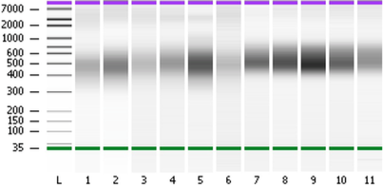
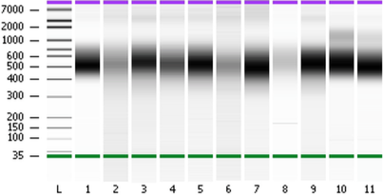
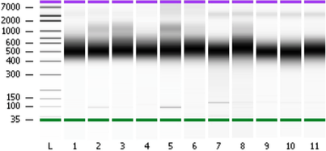
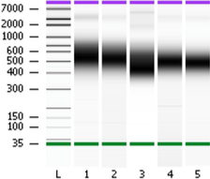
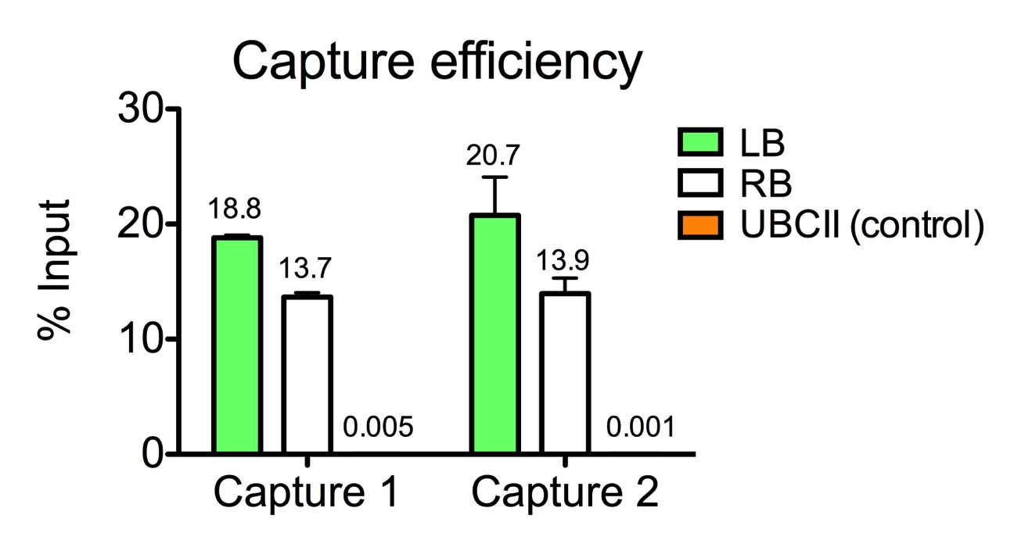
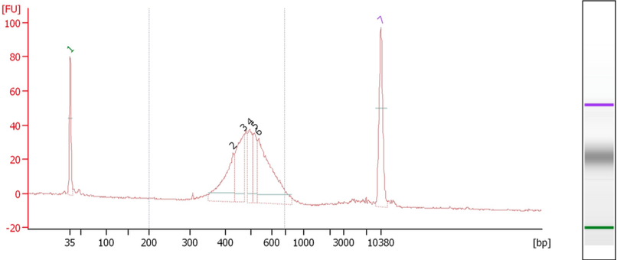
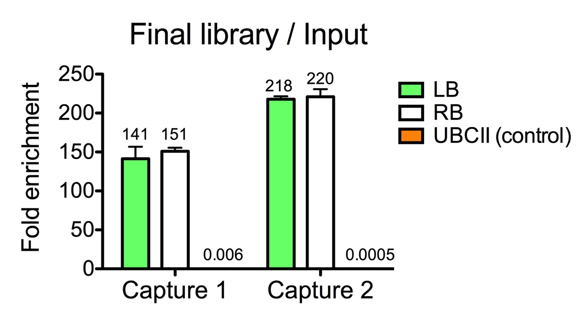
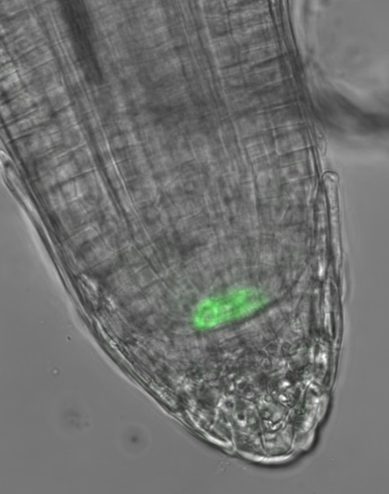
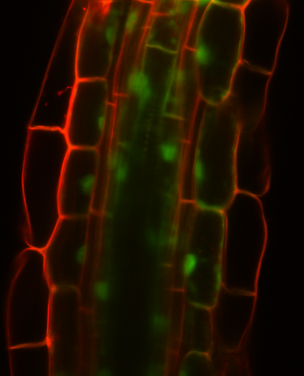




Facile Mapping of T-DNA Insertion Sites for a Cell-type Gene Expression Toolbox of Rice
Joel A. Velasco^{1,2}, Mauricio A. Reynoso³, Germain Pauluzzi³ & Julia Bailey-Serres³
¹: Center for Plant Cell Biology REU Site: Research Experience for Undergraduates in Next Generation Plant Cell Biology. Department of Botany and Plant Sciences, University of California at Riverside
²: Department of Biological Sciences, Boise State University, Boise, ID
³: Center for Plant Cell Biology, Department of Botany and Plant Sciences, University of California at Riverside
(1) Introduction
(5) Workflow
INTACT and TRAP technologies developed in the model plant Arabidopsis allow for cell-type specific gene expression analysis. To translate INTACT and TRAP to an important crop species, transgenic rice (Oryza sativa) lines containing the TRAP and INTACT constructs were developed. Shown here is a facile process of identifying the number and location of Transfer DNA (T-DNA) insertions containing the mentioned constructs, within genomic DNA (gDNA), of a transgenic collection. Knowledge of the insertion site and the location of INTACT /TRAP construct expression will be used to select the best lines for further use. This toolbox will be employed to study how physiology and development is perturbed by two major environmental threats: droughts and floods.
Genomic DNA (gDNA) was extracted from young leaf tissue of 270 transgenic rice lines
X 270 lines
38 pools of gDNA from transgenic lines carrying constructs with different promoters
X 38
(2) TRAP and INTACT Technologies
Isolation of Nuclei Tagged in Specific Cell Types (INTACT)
Promoter A
Promoter B
Promoter C
Promoter D
Promoter E
Promoter F
gDNA sheared by sonication, ~400bp fragments were selected using AMPure XP Beads
Chromatin
ER
mRNA
AAAA…
Access to nuclear chromatin and RNA
X 38
Pre-mRNA
Isolation of nuclei from specific cell types
Sonication
Sheared gDNA
AMPure XP beads
Size selected gDNA
mRNA
AAAA…
Y
Polysomal mRNA
INTACT construct makes this possible
38 libraries for Illumina sequencing generated from 38 pools
AAAA…
Translating Ribosome Affinity Purification (TRAP)
1
1
1
1
smRNA
1
1
X 38
Y
End repair, polyadenylation, adapter ligation, and amplification
1
1
1
1
FLAG-tagged ribosomes
1
1
1
1
Access to polysomal RNA
1
1
1
1
Size selected gDNA
1
1
Nuclear tagging fusion (NTF)
Y
Libraries ligated with unique barcodes:
1
38
Biotin-tagged protein associated to nuclear envelope (NTF)
Isolation of translating ribosomes from specific cell types
Libraries 1 - 38
Border-junction Capture Efficiency
Cytosol
TRAP construct makes this possible
Capture Efficiency for Left (LB) and Right (RB) Border sequences
(3) Cell Types Targeted with Specific Promoters
Multiplexed
Cell Type | Promoter | Lines
Pericycle | OsHMA5 | 34
Root hairs | OsEXPB5 | 7
Meristematic endodermis | AtSCR | 18
Endo/Exodermis | OsLSI2 | 26
Root vasculature | OsNRAMP3 | 19
Root meristem | OsRSS1 | 40
Root cortex | OsCMZ | 26
Quiescent center | OsQHB | 17
Shoot meristem | OSH1 | 15
Endodermis | OsCASP | 21
Near-constitutive | CaMV 35S | 47
 | Total | 270
TRAP Construct
Border-junction Capture
Promoter
HF
GFP
OsRPL18
Amplification
Fold enrichment for LB and RB after amplification
Promoter
INTACT Construct
Arbitrary units
WPP
GFP
BLRP
Multiplexed Library sequenced on Illumina MiSeq
Confocal microscopy showing GFP-RPL18 for pOsQHB and pOsLSI2 TRAP lines
(6) Sequence Analysis and T-DNA insertion mapping*
MiSeq 2 x 250bp Sequence Data
* 5,718,350 paired end reads for 21 lines
(min 94,890, max 652,658)
flash
Overlapping paired-end reads
* 4,775,720 longer reads (390 bp)
(83%, min 73,547, max 534,791)
grep
Filter reads containing LB RB sequences
* 229,856 border containing reads
(4.8%, min 2079, max 31,885)
Quiescent center
Endo/Exodermis
Bowtie2 - local
(4) T-DNA & Border-junction Capture
Map Border–gDNA junction reads to genome
* 154,342 junction reads
(67.1%, min 1,095, max 20,101
Transfer DNA (T-DNA) insertion
readGAligments, coverage, peaks
Transgenic Cell
Random
Coverage >100 reads for each insertion site
* 26 different insertions mapped
Sometimes multiple
* Unpublished data from protocol development
Chromatin
Not always complete
Expression | Line | # of insertions | Chr Location | Nearest Gene
Near-constitutive | 35S:TRAP 1 | 1 | Chr 4 | LOC_Os04g18140
Near-constitutive | 35S:TRAP 2 | 1 | Chr 8 | LOC_Os08g31100
Near-constitutive | 35S:TRAP 3 | 1 | Chr 4 | LOC_Os04g55800
Near-constitutive | 35S:INTACT 1 | 1 | Chr 4 | LOC_Os04g08660
Near-constitutive | 35S:INTACT 2 | 1 | Chr 6 | LOC_ Os06g43090
Near-constitutive | 35S:INTACT 3 | 1 | Chr 8 | LOC_Os08g08440
Quiescent center | QHB:TRAP 1 | 2 | Chr 6 | LOC_Os06g36590
Quiescent center | QHB:TRAP 2 | 1 | Chr 9 | LOC_Os09g12290
Quiescent center | QHB:TRAP 3 | 4 | Chr 1, 2 , 3, 5
Quiescent center | QHB:TRAP 4 | 2 | Chr 11 | LOC_Os11g38462
Shoot meristem | OSH1:TRAP 1 | 1 | Chr 3 | LOC_Os03g30260
Shoot meristem | OSH1:TRAP 2 | 1 | Chr 2 | LOC_Os02g40454
Endo/Exodermis | LSI1:TRAP 1 | 1 | Chr 12 | LOC_Os12g02710
Endo/Exodermis | LSI1:TRAP 2 | 1 | Chr 7 | LOC_Os07g10990
Endo/Exodermis | LSI1:TRAP 3 | 2 | Chr 10, 11
Endo/Exodermis | LSI1:TRAP 4 | 1 | Chr 11 | LOC_Os11g04030
Endo/Exodermis | LSI1:TRAP 5 | 1 | Chr 10 | LOC_Os10g08280
Root stele | SHR1:TRAP 1 | 3 | Chr 1, 3 , 8
Root stele | SHR1:TRAP 2 | 1 | Chr 11 | LOC_Os11g17200
Root stele | SHR1:TRAP 3 | 1 | Chr 5 | LOC_Os05g07950
Root stele | SHR1:TRAP 4 | 2 | Chr 1 | LOC_ Os01g57110
Border-junction Capture
T-DNA
Capture probes ( ) hybridized to border sequences
Streptavidin beads bind capture probes
TRAP Insertion
Streptavidin bead
gDNA
RB
Promoter
HF
GFP
OsRPL18
LB
gDNA
INTACT Insertion
(7) Conclusion: 256 transgenic lines are on queue sequencing (MiSeq). T-DNA mapping information, along with visualized expression of GFP, will be used to select lines for further analysis
gDNA
RB
Promoter
WPP
GFP
BLRP
LB
gDNA
References:
Contact info:
This work is supported by:
Bailey-Serres, J. (2013). Microgenomics: Genome-Scale, Cell-Specific Monitoring of Multiple Gene Regulation Tiers. Annual Review of Plant Biology 64, 293–325.
Lepage, É., Zampini, É., Boyle, B., and Brisson, N. (2013). Time- and Cost-Efficient Identification of T-DNA Insertion Sites through Targeted Genomic Sequencing. PLoS ONE 8, e70912.
Tzfira, T., Li, J., Lacroix, B., and Citovsky, V. (2004). Agrobacterium T-DNA integration: molecules and models. Trends in Genetics 20, 375–383.
- joelvelasco84@gmail.com
- NSF REU - 1461297
- NSF DBI - 1238243

